Slide 1
Auto Start
Jacob Konicke

Slide 2
Reason
People enjoy comfort and convenience
People enjoy messing with others
People are lazy
I needed to pitch something

Slide 3
Proposal
Develop an app that allows users to start their car and access different utilities within it from within their house

Slide 4
Target Audience
Anyone who owns a push to start car
2016 Chevrolet Camaro
2016 Mazda Mazda6
2016 RAM 2500
2016 Acura ILX
2016 Buick Verano
2016 Cadillac ATS-V

Slide 5
What does it do?
Takes signal from key and stores it for 30 min.
Allows user to start car from within home and turn on the heater
Tells user when car is turned on when user is a specific distance away
Allows user to change the radio
Turn on seat warmer
Allows you to lock/unlock car

Slide 6
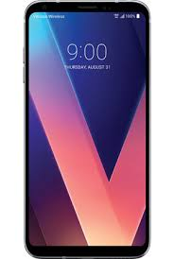



Mock up

Slide 7
Timeline
March 12 - 18: Obtain a push to start car
March 19 - 25: Get the app to register and store the signal
March 26 - April 1: Get the app to turn the car and heater on
April 2 - 8: Get the app to change the radio and/or seat warmer
April 9 - 15: Test and fix any bugs that may have occurred

Slide 8
April 16 - 22 : Get the app to Lock and unlock the car doors and inform user when they are unlocked through other means
April 23 - 29 : Further test and fix any bugs
April 30 : Show what we have finished

